Slide 1
USED CARS PRICE ANALYSIS
Presented by t. Abhinav

Slide 2
OVERVIEW
The used car market in India has grown rapidly, offering an affordable alternative for consumers looking for high-quality vehicles at lower prices. Platforms like Cars24 provide a comprehensive listing of used cars, including various car companies, fuel types, and transmission systems. This project analyzes the variation in car prices across different factors to help consumers make better decisions when purchasing used cars. However, the price of used cars can vary significantly based on numerous factors such as:
Company Name
Fuel Type
Distance Driven
Prices

Slide 3
OBJECTIVES
The primary objectives of this project are:
To analyze car price variation across different companies in the used car market.
To identify cars that provide good quality at a lower price (value-for-money cars).
To study the impact of factors such as car age, distance driven, fuel type and transmission on car prices.
To study the company wise car availability in each city.

Slide 4
METHODOLOGY
DATA COLLECTION
Utilized Python with Beautiful soup and selenium for web scrapping to gather detailed data on used car listings from Cars24 in different cities.
Extracted key information including Company name, Year Of Manufacture, Fuel type, Distance Driven and Price.
Analyzed market trends and pricing patterns of used cars across different cities.
DATA CLEANING
After collecting the raw data, the next step is Data cleaning. The goal of this phase is to ensure the dataset is free from errors, missing values, and irrelevant information.
Removing the Duplicates and the Null Values.
Replacing the missing values with relevant placeholders.

Slide 5
DATA NORMALISATION
Normalizing prices and other numeric fields to standard formats. For example, prices are converted to a uniform format (in lakhs), and also Distance Driven values are converted into the numerical fields.
DATA VISUALIZATION
After Cleaning the dataset, the next step is Data visualization, which helps in understanding the relationships between various factors like car company, price, Distance Driven and Fuel type.
Tools Used: Power BI
For creating interactive and dynamic dashboards that allow users to filter data and explore trends across different car companies, fuel types, and etc.

Slide 6
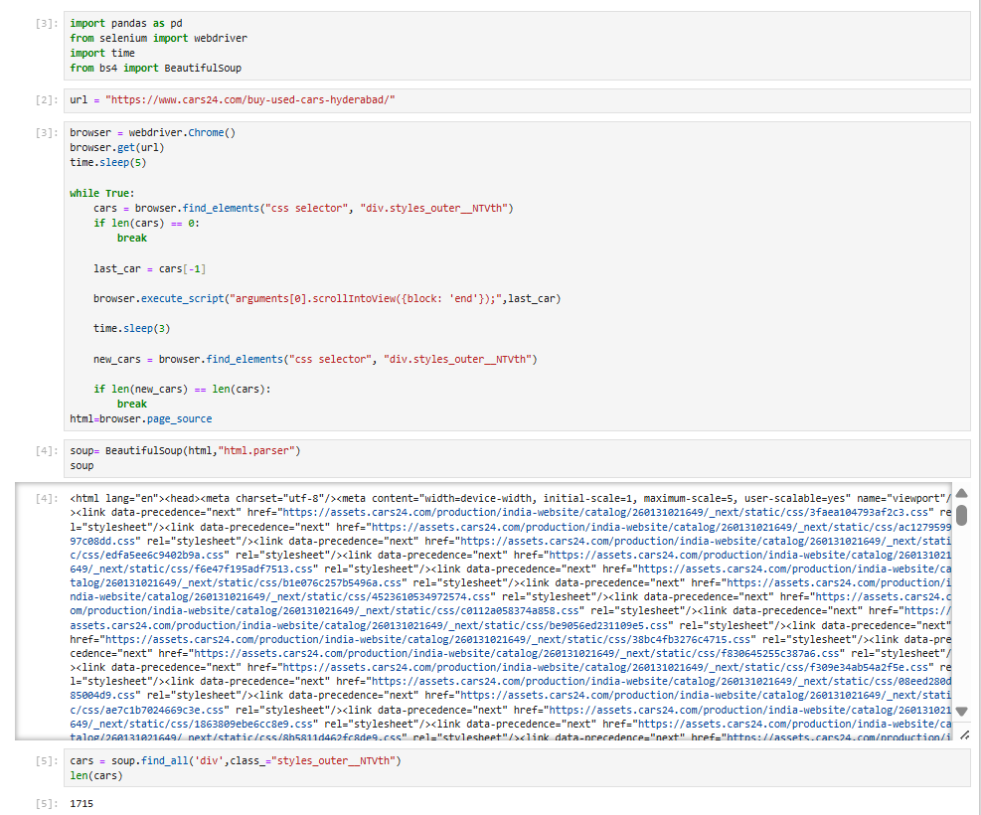

Slide 7
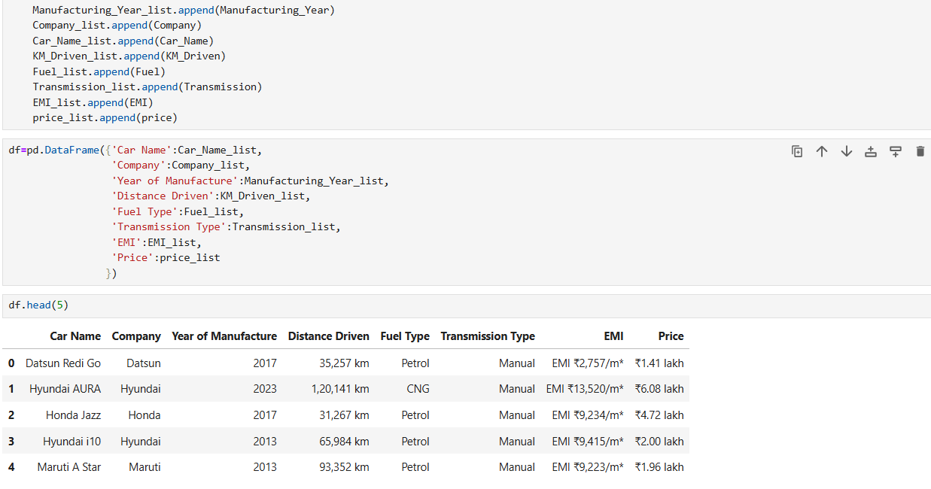

Slide 8
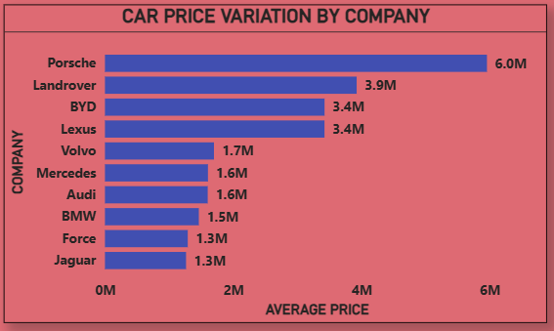
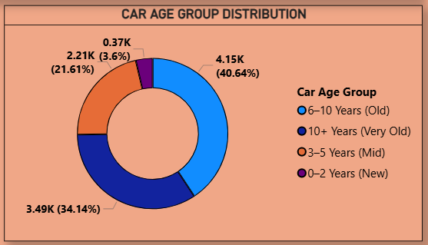
VISUALIZATIONS

Slide 9
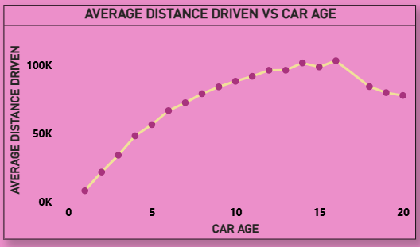
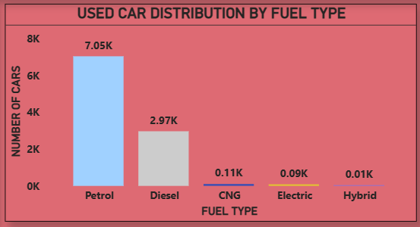

Slide 10
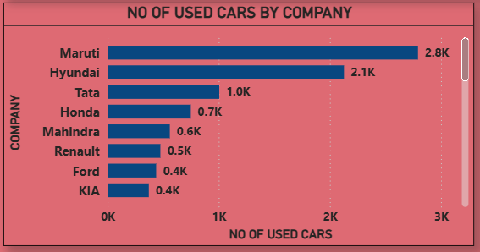

Slide 11
CHALLENGES FACED
Initially, Data extraction using BeautifulSoup was unsuccessful due to the dynamic nature of the website and JavaScript-rendered content. To overcome this limitation, Selenium was used to automate browser interactions and successfully fetch the required data.
The dataset contained missing values, inconsistent data formats (such as price, distance driven, and EMI), and incorrect or unrealistic entries. These issues were overcome by performing data cleaning techniques including handling missing values, standardizing units and formats

Slide 12
CONCLUSION
This analysis shows that car price is mainly influenced by company, vehicle age, and usage, with clear depreciation as car age and distance driven increase.
Petrol cars dominate the market and most used cars fall in the mid-price and mid-age segments.
By understanding factors such as company, car age, usage, and customer demand, sellers can price vehicles more accurately.
These insights help improve sales planning, meet customer expectations, and stay competitive in the used car market.

